Slide 1
MGB235 MONITORING AND MANAGING OPERATIONAL PERFORMANCE
Week 7: Processes and technology
Chapter 6:
Stevenson, W.J. (2021) 14th ed. Operations Management, McGraw Hill, New York, NY.
Chapter 6:
Russell, Roberta S., and Taylor III, Bernard W. (2017) Operations management:
Creating value along the supply chain, 9th ed., Hoboken, NJ.

Slide 2
Lecture Outline
Process Planning
Process Analysis
Process Innovation
Technology Decisions
How Service Technology is enhancing the Business Relationship
Technology Challenges

Slide 3
1. Process Planning
Process
Group of related tasks with specific inputs & outputs
Process strategy
an organization’s overall approach for physically producing goods and services
Process design
tasks to be done & how they are coordinated among functions, people, & organizations
Process planning
converts designs into workable instructions for manufacture or delivery

Slide 4
Process Strategy
Vertical integration
extent to which firm will produce inputs and control outputs of each stage of production process
Capital intensity
mix of capital (i.e., equipment, automation) and labor resources used in production process
Process flexibility
ease with which resources can be adjusted in response to changes in demand, technology, products or services, and resource availability
Customer involvement
role of customer in production process

Slide 5
Outsourcing
Cost
Is it cheaper to make or buy the item?
Capacity
Does the company have the capacity?
Quality
Easier to control quality in your own factory
Speed
Shipping time can reduce savings
Reliability
Quality and timing are reliability measures
Expertise
Protect proprietary information

Slide 6
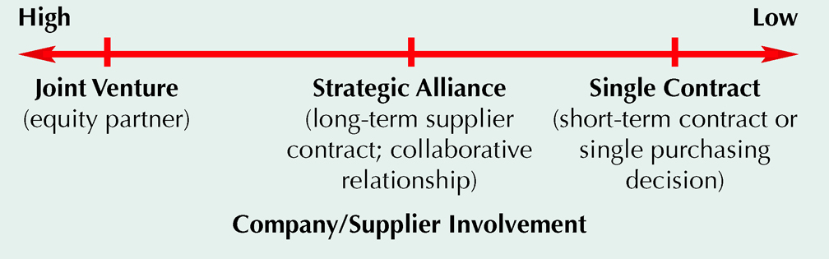
Sourcing Continuum

Slide 7
Process Selection
Process selection
Refers to deciding on the way production of goods or services will be organized
It has major implications for
Capacity planning
Layout of facilities
Equipment
Design of work systems
Two key questions in process selection:
How much variety will the process need to be able to handle?
How much volume will the process need to be able to handle?
Copyright ©2021 McGraw-Hill Education. All rights reserved. No reproduction or distribution without the prior written consent of McGraw-Hill Education.

Slide 8
Process Selection
Projects (or Job shop)
one-of-a-kind production of a product to customer order
Batch production
process many different jobs at the same time in groups or batches
Mass production (repetitive/Assembly)
produce large volumes of a standard product for a mass market
Continuous production
used for very-high volume commodity products

Slide 9
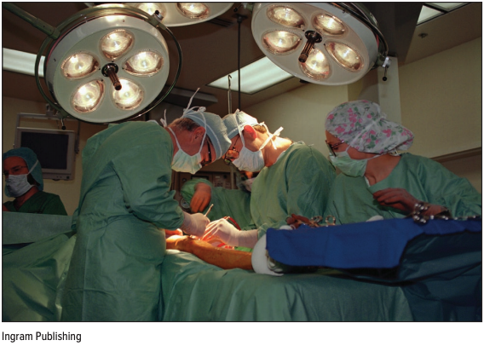
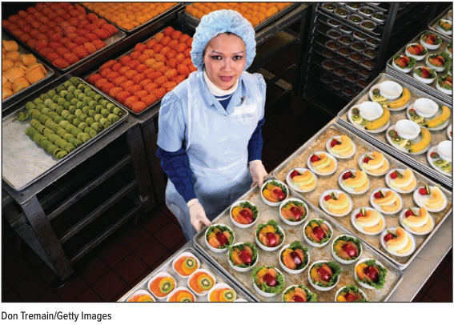
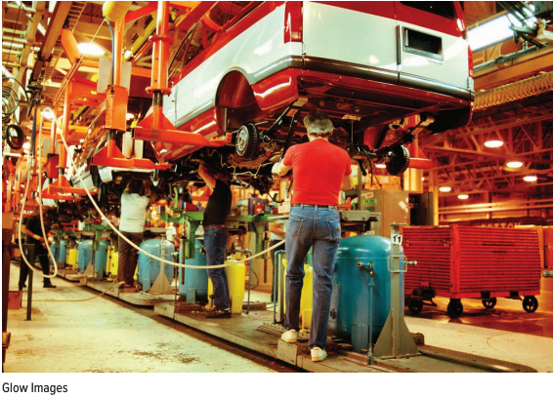
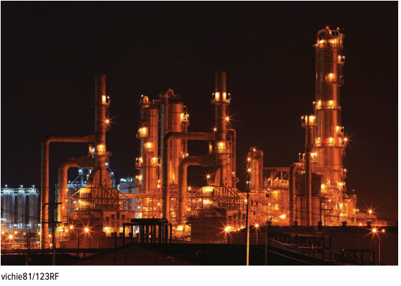
Process Types
A job shop
A batch process
A repetitive process
A continuous process
Copyright ©2021 McGraw-Hill Education. All rights reserved. No reproduction or distribution without the prior written consent of McGraw-Hill Education.

Slide 10
Product-Process Matrix

Slide 11
Types of Processes
PROJECT
BATCH
MASS
CONT.
Type of product
Unique
Made-to- order
(customized)
Made-to- stock
(standardized )
Commodity
Type of customer
One-at-a-time
Few individual
customers
Mass
market
Mass
market
Product demand
Infrequent
Fluctuates
Stable
Very stable

Slide 12
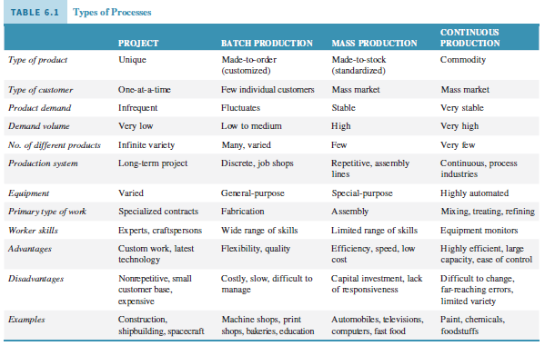

Slide 13
Sustainable Production of Goods and Services
There is increasing pressure for organizations to operate sustainable production processes
According to the Lowell Center for Sustainable Production:
“Sustainable Production is the creation of goods and services using processes and systems that are: non-polluting; conserving of energy and natural resources; economically efficient; safe and healthful for workers, communities, and consumers; and, socially and creatively rewarding for all working people.” https://www.uml.edu/research/lowell-center/
Copyright ©2021 McGraw-Hill Education. All rights reserved. No reproduction or distribution without the prior written consent of McGraw-Hill Education.

Slide 14
Process Selection with Break-Even Analysis (the outsourcing decision)
Study cost trade-offs based on demand volume
Costs
Fixed costs
constant regardless of the number of units produced
Variable costs
vary with the volume of units produced
Revenue
price at which an item is sold

Slide 15
Process Selection with Break-Even Analysis
Total Revenue
price times volume sold
Profit
difference between total revenue and total cost

Slide 16
Process Selection with Break-Even Analysis
Total cost = fixed cost + total variable cost
TC = c_{f} + vc_{v}
Total revenue = volume x price
TR = vp
Profit = total revenue - total cost
Z = TR – TC = vp - (c_{f} + vc_{v})
c_{f} = fixed cost
V = volume (i.e., number of units produced and sold)
c_{v} = variable cost per unit
p = price per unit

Slide 17
Process Selection with Break-Even Analysis
TR = TC
vp = c_{f} + vc_{v}
vp - vc_{v} = c_{f}
v(p - c_{v}) = c_{f}
v =
c_{f}
p - c_{v}
Solving for Break-Even Point (Volume)

Slide 18
Break-Even Analysis (outsourcing: make or no make decision)
Fixed cost = c_{f} = $2,000
Variable cost = c_{v} = $50 per unit
Price = p = $100 per unit
Break-even point is
c_{f}
p - c_{v}
2000
100 - 50
v = = = 40 units

Slide 19
Break-Even Analysis: Graph
Dollars
$3,000 —
$2,000 —
$1,000 —
Total cost line
Total revenue line
40 Units
Break-even point

Slide 20
Process Selection – Multiple Processes
Process A (outsource) Process B
$2,000 + $50v = $10,000 + $30v
$20v = $8,000
v = 400 units
Below or equal to 400, choose A
Above or equal to 400, choose B

Slide 21
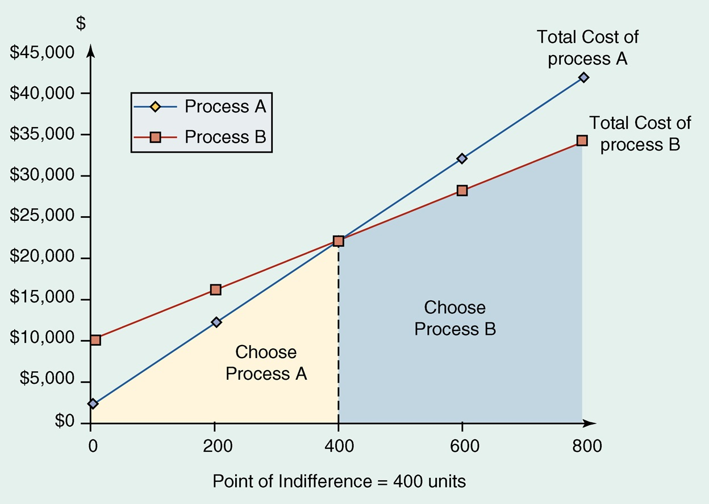
Multiple Processes – Indifference Point

Slide 22
With the process option selected: Plan the Process
Set of documents that detail manufacturing, service & delivery specifications (based on the product design)
assembly charts
operations sheets
quality-control check-sheets

Slide 23
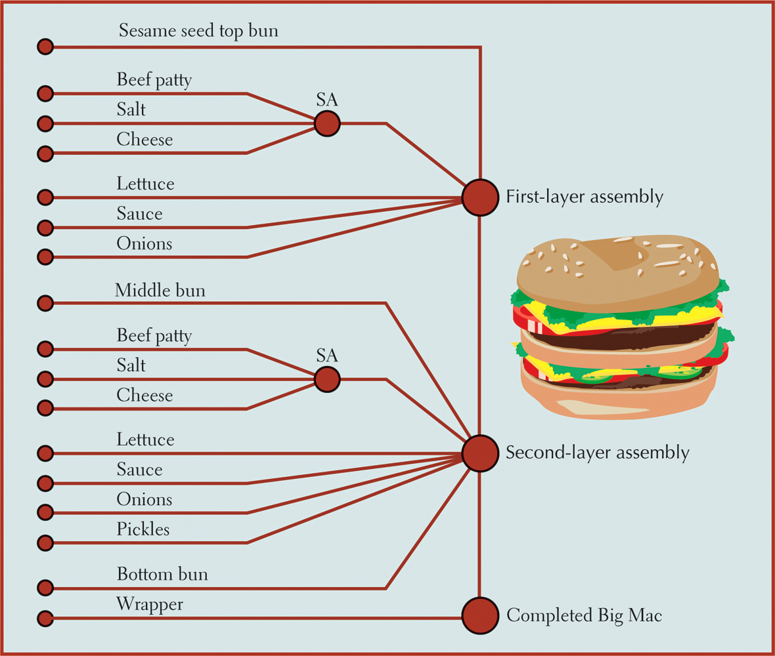
Assembly Chart

Slide 24
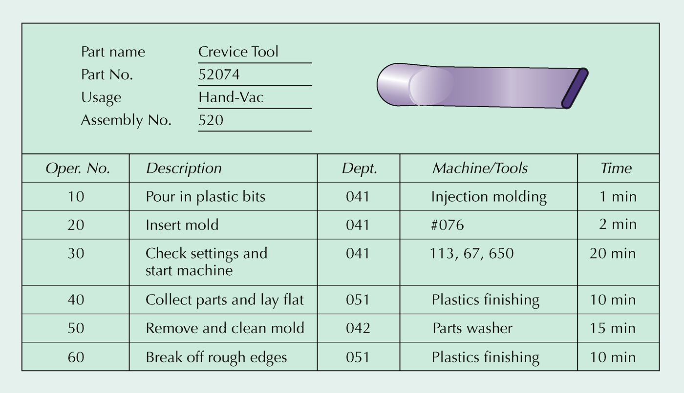
Operations Sheet for Plastic Part

Slide 25
2. Process Analysis
Systematic study of all aspects of a process
make it faster
more efficient
less costly
more responsive
Basic tools
process flowcharts
diagrams
maps

Slide 26
Process Flowcharts
Look at manufacture of product or delivery of service from broad perspective
Incorporate
nonproductive activities (inspection, transportation, delay, storage)
productive activities (operations)

Slide 27
Building a Flowchart
Determine objectives
Define process boundaries
Define units of flow
Choose type of chart
Observe process and collect data
Map out process
Validate chart

Slide 28
Flow Charts in Microsoft Visio

Slide 29
Process Flowchart Symbols
Operation
Inspection
Transportation
Delay
Storage

Slide 30
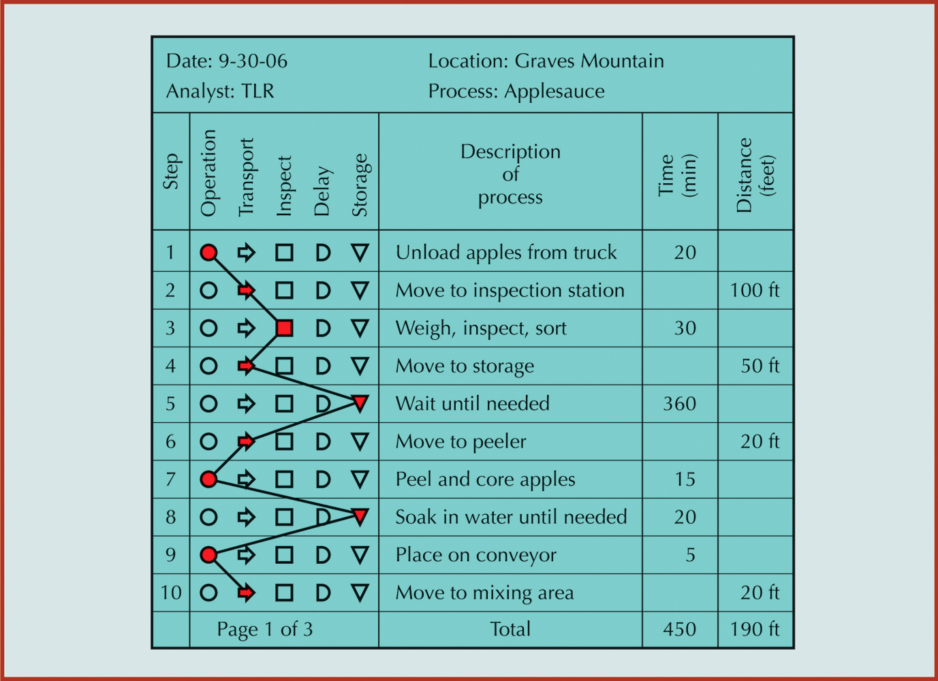
Process Flowchart of Apple Processing

Slide 31
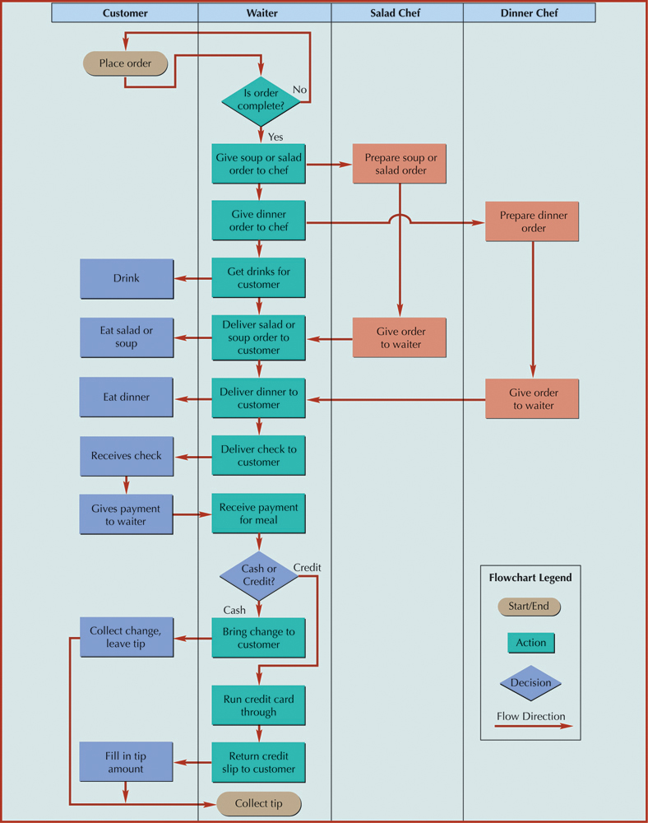
Process Map* or Swimlane Chart for a Restaurant Service

Slide 32
3. Process Innovation
Total redesign of a process for breakthrough improvements
Continuous improvement refines the breakthrough
Breakthrough Improvement
Continuous improvement activities peak; time to reengineer process

Slide 33
From Function to Process
Product Development
Order Fulfillment
Accounting
Purchasing
Manufacturing
Sales
Supply Chain Management
Customer Service
Function
Process

Slide 34
Process Innovation
Strategic
Directives
Baseline Data
Customer
Requirements
Goals for Process Performance
Benchmark
Data
High - level
Process map
Innovative
Ideas
Design
Principles
Detailed
Process Map
Model
Validation
Key
Performance
Measures
Pilot Study
of New Design
Goals
Met?
Full Scale
Implementation
No
Yes

Slide 35
High-Level Process Map

Slide 36
Principles for Redesigning Processes
Remove waste, simplify, and consolidate similar activities
Link processes to create value
Let the swiftest and most capable enterprise execute the process
Flex process for any time, any place, any way
Capture information digitally at the source and propagate it through process
Provide visibility through fresher and richer information about process status
Fit process with sensors and feedback loops that can prompt action
Add analytic capabilities to the process
Connect, collect, and create knowledge around process through all who touch it
Personalize process with preferences and habits of participants

Slide 37
4. Technology Decisions Financial Justification of Technology
Purchase cost
Includes add-ons to make technology work
Operating Costs
Visualize how the technology will be used
Annual Savings
Better quality and efficiency save money
Revenue Enhancement
New technology can enhance revenue
Replacement Analysis
When to upgrade to new technology depends on competitive environment
Risk and Uncertainty
Investment in new technology can be risky
Piecemeal Analysis
Make sure new and existing technology are compatible

Slide 38
Process and Information Technology
Process and information technology can have a major impact on costs, productivity and competitiveness:
Process technology
Methods, procedures, and equipment used to produce goods and provide services
Information technology
The science and use of computers and other electronic equipment to store, process, and send information
Copyright ©2021 McGraw-Hill Education. All rights reserved. No reproduction or distribution without the prior written consent of McGraw-Hill Education.

Slide 39
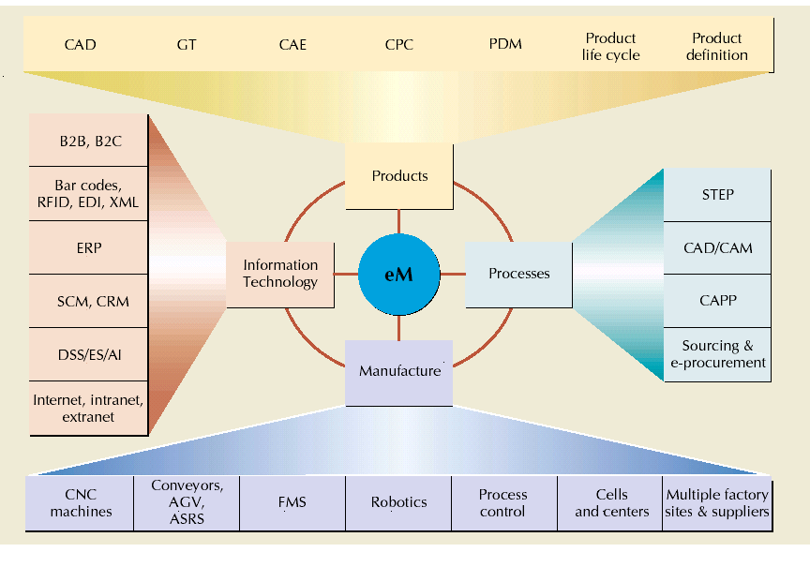
Components of e-Manufacturing

Slide 40
Information Technology: Some Examples
Bar Codes
Radio Frequency Identification tags (RFID)
Extensible markup language (XML)
Enterprise resource planning (ERP)
Supply chain management (SCM)
Customer relationship management (CRM)
Decision support systems (DSS)
Expert systems (ES)
Artificial intelligence (AI)

Slide 41
5. How eService Technology is enhancing the Business & Customer Relationship
eService Technology; Service technologies used behind the scenes to facilitate your experience as a customer:
e.g. WebJet
e.g. Technology has been used extensively in financial services to facilitate the large number of transactions and processing activities that must occur each day. BPay
e.g. Many health care facilities are adopting electronic medical record (EMR) systems that can be easily integrated with medical records, billing, patient scheduling, and accounting (e.g. Taiwan* v USA); “Taiwan spends 6.23 percent of its GDP each year on health care. In comparison, the United States spends 16 percent” *
e.g. eService Technology at UPS such as handheld devices, UPSnet, UPS Mail, etc.
6-41

Slide 42
6. Technology Challenges
Many Benefits
e.g. Logistical costs for information intensive services (music) are much cheaper for online businesses.
Many Challenges
e.g. Customer concerns; online security, privacy issues.
e.g. Supplier concerns; music piracy
e.g. Logistical costs for manufactured goods are expensive for online businesses; Product returns to a virtual store?
People – Process & Change e.g. iPhone
6-42

Slide 43
In the Lecture we covered:
Process Planning
Process Analysis
Process Innovation
Technology Decisions
How Service Technology is enhancing the Business Relationship
Technology Challenges
6-43

